Slide 1


IPL Data Analysis
For Sports Basics Magazine
By Abhijeet Kumar

Slide 2
Introduction
Our goal is to analyze data from the last 3 years of IPL matches and uncover the most intriguing stories, trends and captivating insights for the newly launched "Sports Basics" magazine.

Slide 3
Dataset Overview
We have been provided 4 csv files:
Dimension Tables
dim_match_summary
dim_players
Fact Tables
fact_batting_summary
fact_bowling_summary

Slide 4
Leading Batsmen Dashboard
Primary Insights

Slide 5
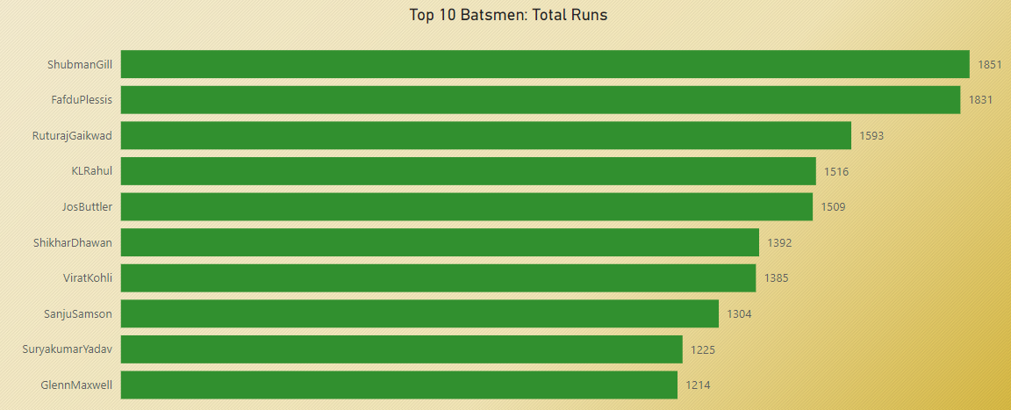
Top 10 batsmen based on past 3 years total runs scored

Slide 6
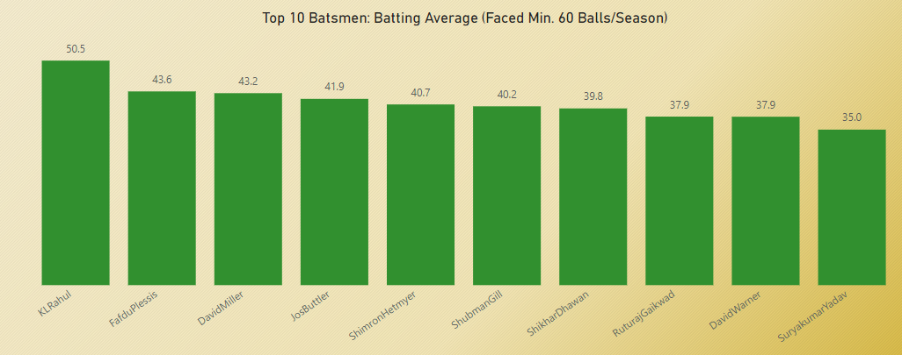
Top 10 batsmen based on past 3 years batting average. (min 60 balls faced in each season)

Slide 7
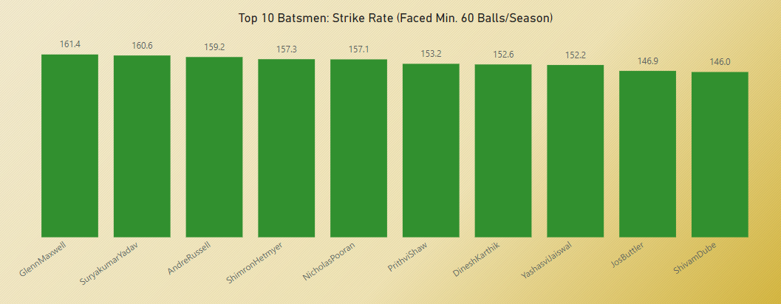
Top 10 batsmen based on past 3 years strike rate (min 60 balls faced in each
season)

Slide 8
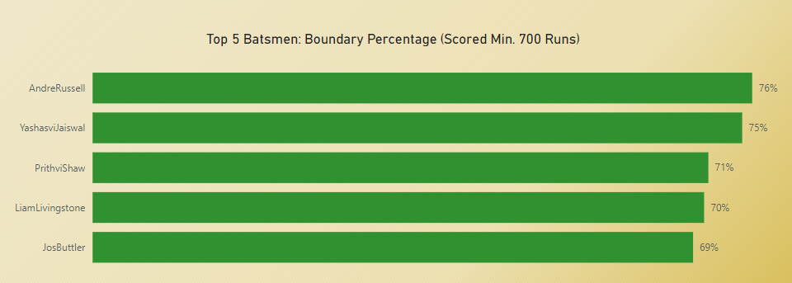
Top 5 batsmen based on past 3 years boundary % (fours and sixes)

Slide 9
Leading Bowlers Dashboard
Primary Insights

Slide 10
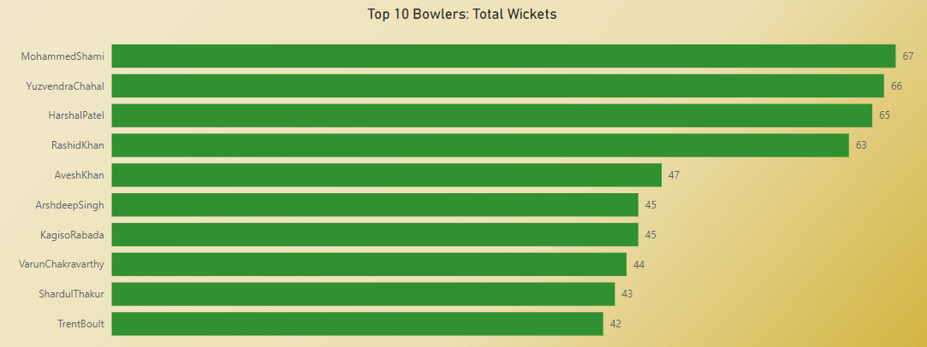
Top 10 bowlers based on past 3 years total wickets taken

Slide 11
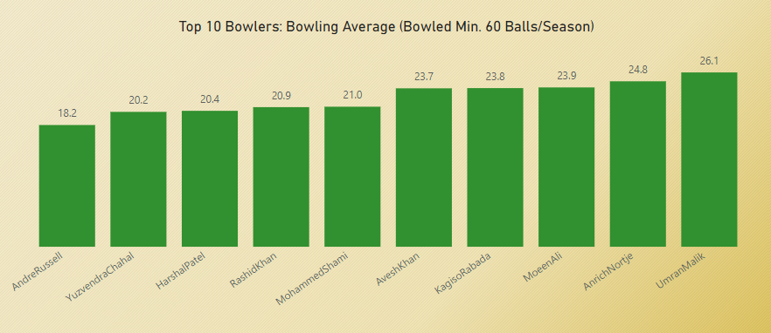
Top 10 bowlers based on past 3 years bowling average. (min 60 balls bowled in
each season)

Slide 12
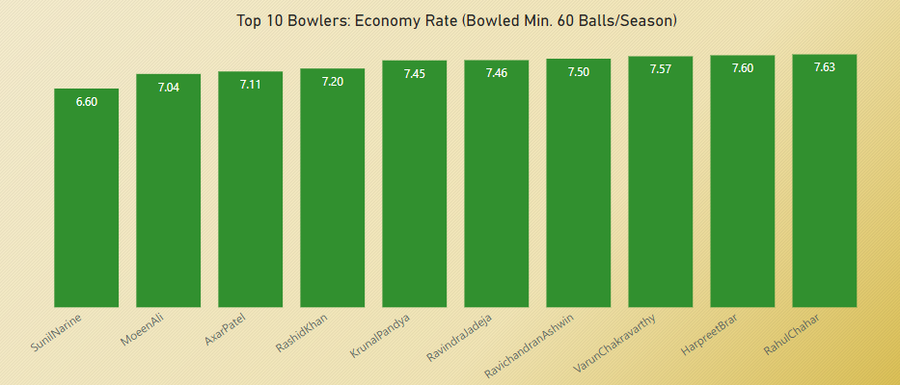
Top 10 bowlers based on past 3 years economy rate. (min 60 balls bowled in
each season)

Slide 13
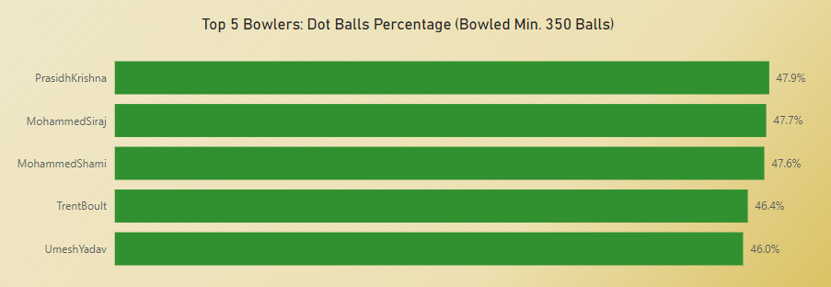
Top 5 bowlers based on past 3 years dot ball %

Slide 14
Leading Teams Dashboard
Primary Insights

Slide 15
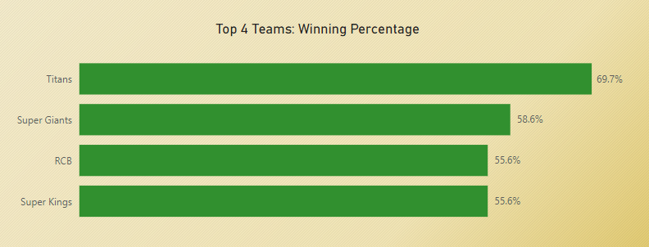
Top 4 teams based on past 3 years winning %

Slide 16
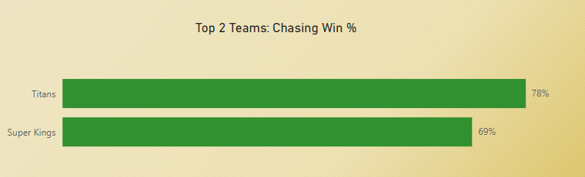
Top 2 teams with the highest number of wins achieved by chasing targets over
the past 3 years

Slide 17
Players Analysis Dashboard
Secondary Insights

Slide 18
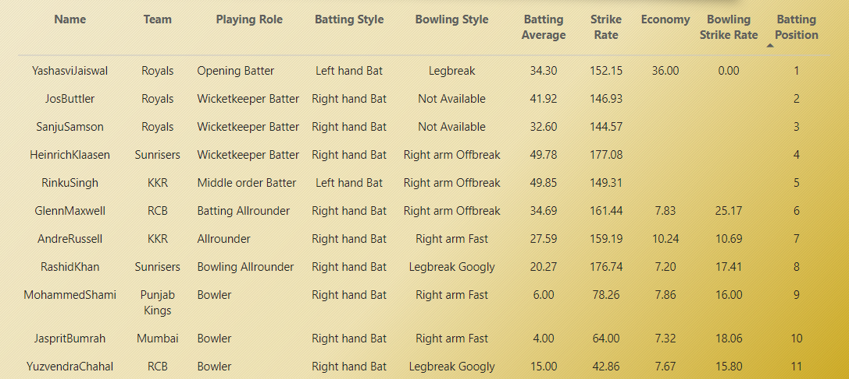
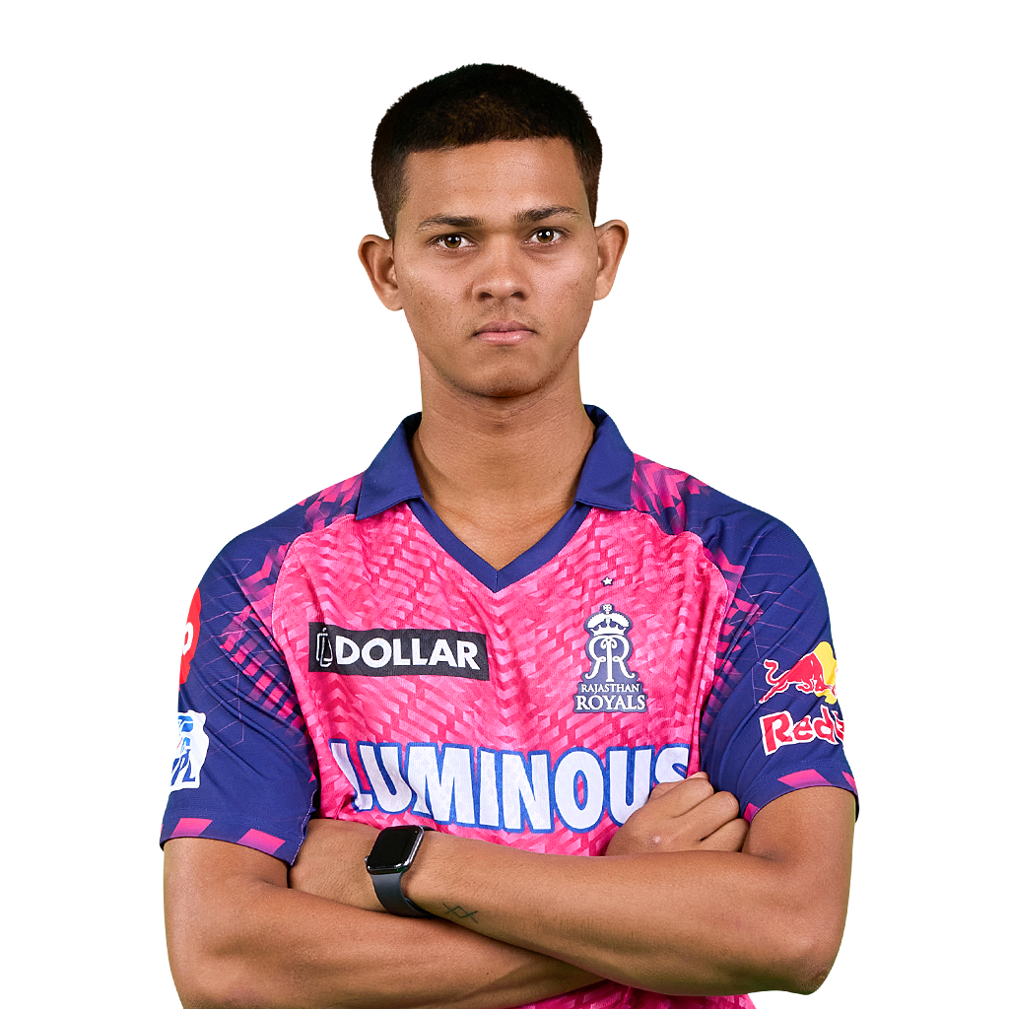

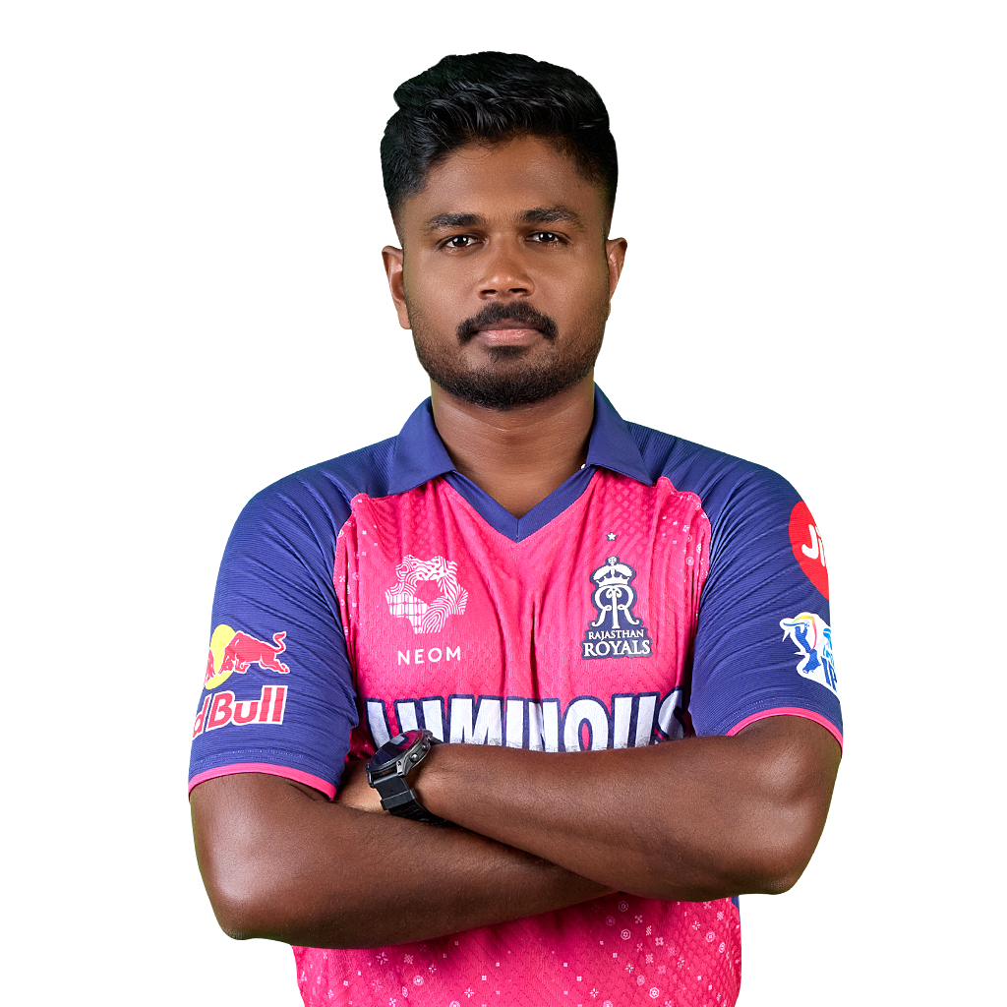

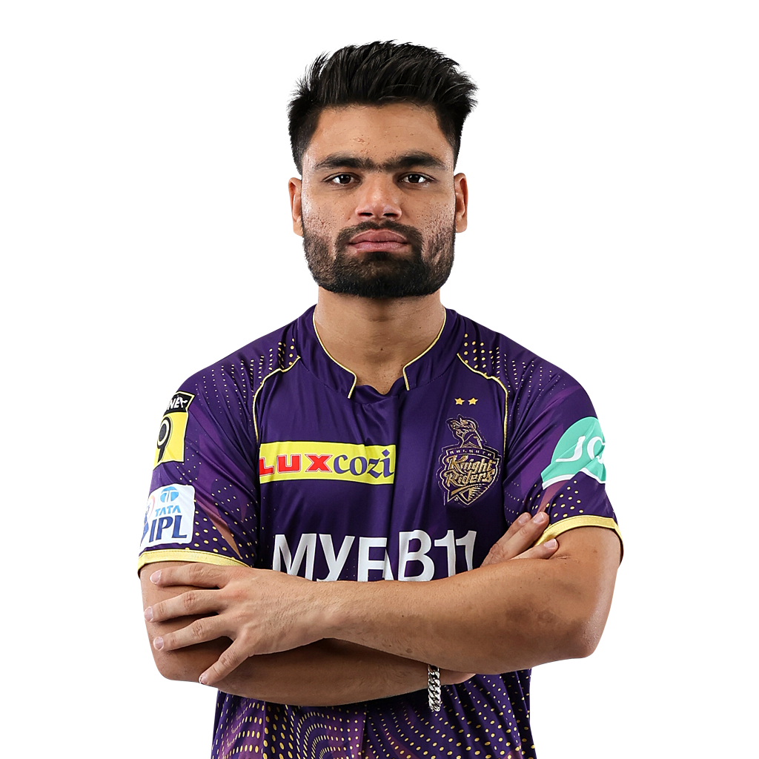

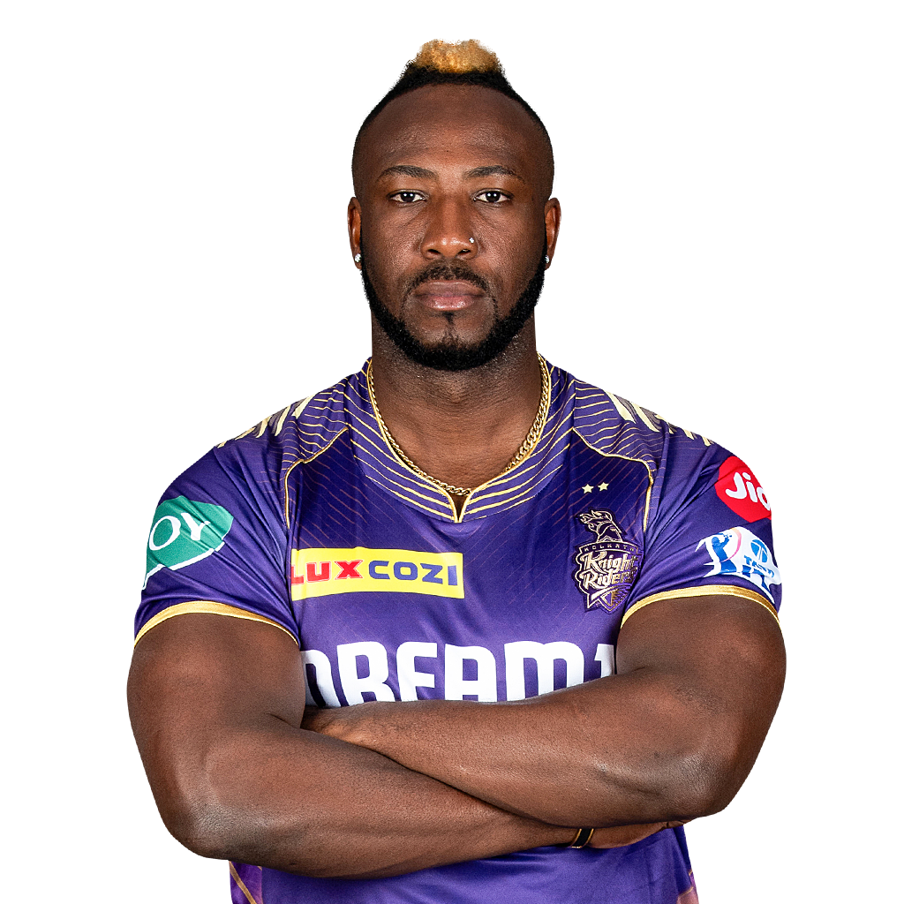
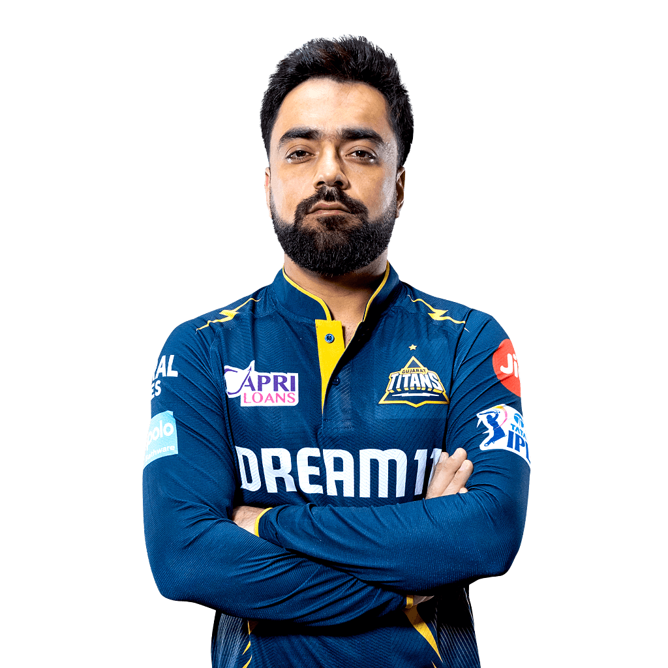
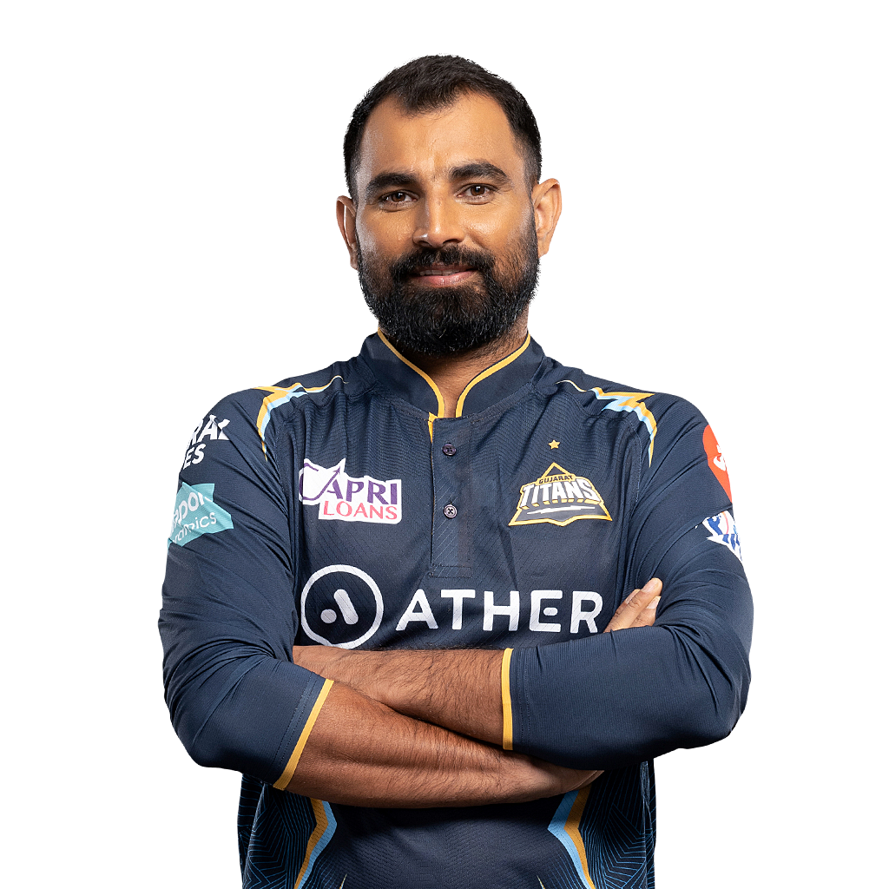
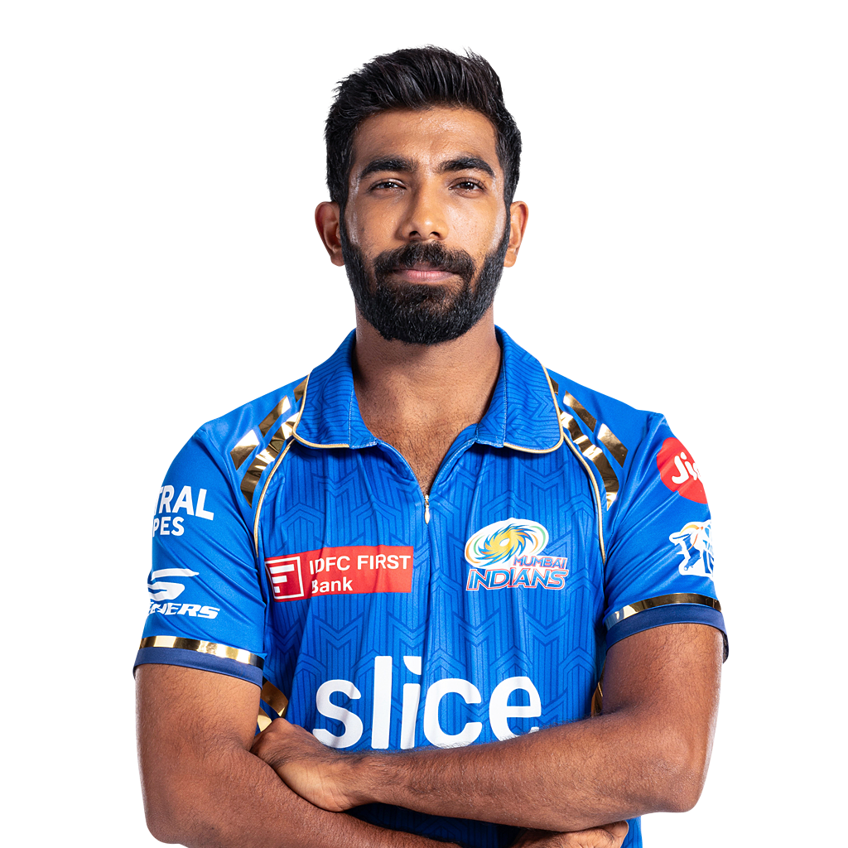

Best 11

Slide 19
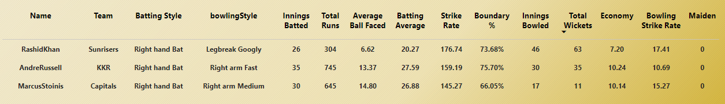

Top 3 All-Rounders

Slide 20
Prediction
Secondary Insights

Slide 21
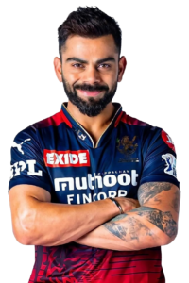
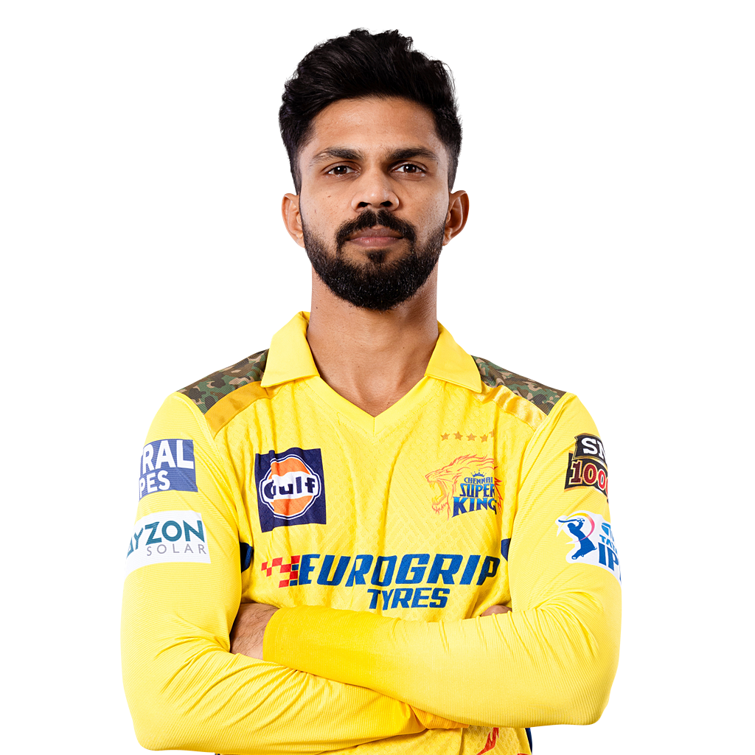



Orange and Purple cap player
Virat Kohli
Ruturaj Gaikwad
Yashasvi Jaiswal
Yuzvendra Chahal
Jasprit Bumrah
Harshal Patel

Slide 22




Top 4 qualifying teams

Slide 23
Winner and Runner-Up
Winner
Runner-Up

Slide 24
Thank You
Special Thanks to Code Basics Team , Dhaval Patel and Hemanand Vadivel

